Slide 1
Presentation Group 1
Presented by Marco, Pablo, Lukas and Thirith

Slide 2
Summary
1) Inventory
2) Learning to make bread
3) Scenarios
4)To good to go
5) Quick demonstration

Slide 3
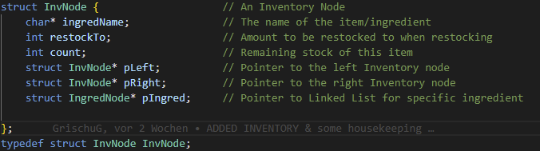
1.Inventory
Binary Tree
One node (InvNode) per ingredient type:
Name of the ingredient
Initial and remaining stock
Holding a linked-list, every node of that list represents one unit of that ingredient
Tree is lexographically sorted -> efficient searching in inventory for ingredient

Slide 4
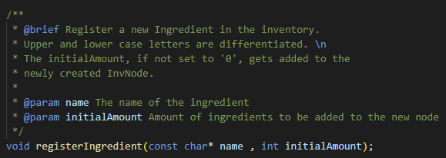
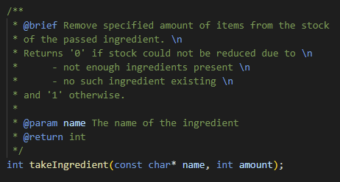
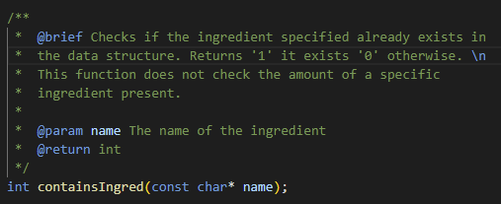
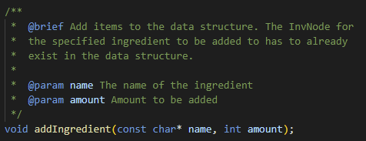
1. Inventory
Methods to register and access ingredients by their name:

Slide 5
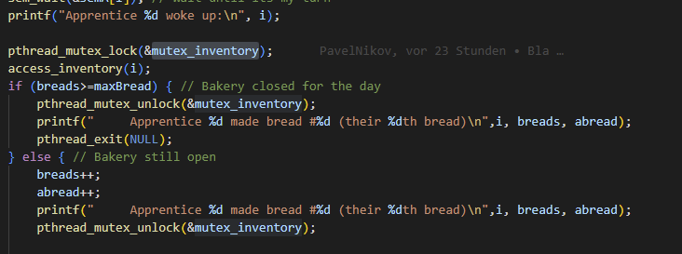
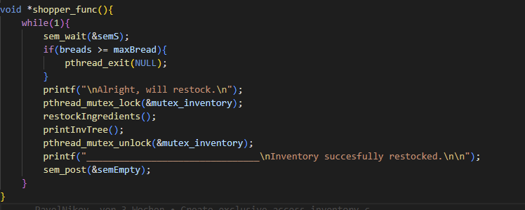
Making Bread
Access to the inventory is protected: Only one client can access the inventory at the same time:
Shopper accessing and apprentice the inventory:

Slide 6


Making Bread
Semaphore for coordination between apprentices, baker and shopper:
Apprentice waits for his turn:
Baker wakes an apprentice:

